Slide 1
Introduction to ASP.Net MVC
Course Code: CSC 4164
Course Title: ADVANCED PROGRAMMING WITH .NET
Dept. of Computer Science
Faculty of Science and Technology
Lecture No: | 06 | Week No: | 03 | Semester: | Fall 2020-21
Lecturer: | Victor Stany Rozario, stany@aiub.edu

Slide 2
Lecture Outline
Use of session in User Authentication
HTML Helpers

Slide 3
Authorization in ASP.NET
Authorization in MVC is controlled through the AuthorizeAttribute attribute and its various parameters. At its simplest, applying the AuthorizeAttribute attribute to a controller or action limits access to the controller or action to any authenticated user.
For example, the following code limits access to the AccountController to any authenticated user.
[Authorize]
public class AccountController : Controller
{
public ActionResult Login()
{
}
public ActionResult Logout()
{
}
}

Slide 4
If you want to apply authorization to an action rather than the controller, apply the AuthorizeAttribute attribute to the action itself:
You can also use the AllowAnonymous attribute to allow access by non-authenticated users to individual actions.
public class AccountController : Controller
{
public ActionResult Login()
{
}
[Authorize]
public ActionResult Logout()
{
}
}
Now only authenticated users can access the Logout function.
[Authorize]
public class AccountController : Controller
{
[AllowAnonymous]
public ActionResult Login()
{………..}
public ActionResult Logout()
{………..} }
This allowS only authenticated users to the AccountController, except for the Login action, which is accessible by everyone, regardless of their authenticated or unauthenticated / anonymous status.

Slide 5
Use of session in User Authentication
Override base class method
ASP.NET has a nice session feature that uses cookies or URL rewriting to associate multiple requests from a user together to form a single browsing session. A related feature is session state, which associates data with a session. Data associated with a session is deleted when a session expires (typically because a user has not made a request for a while).
Create custom class
Override base class method in custom class (with appropriate logic)

Slide 6
public class CustomizeAuthorize : AuthorizeAttribute
{
protected override bool AuthorizeCore(HttpContextBase httpContext)
{
if (httpContext == null)
{
throw new ArgumentNullException("httpContext");
}
IPrincipal user = httpContext.User;
if (!user.Identity.IsAuthenticated)
{
return false;
}
if ((this.Roles.Length > 0) && (!this.Roles.Contains(ReturnUserRole(user.Identity.Name))))
{
return false;
}
return true;
}
Create custom class
Override base class method
[CustomizeAuthorize(Roles = "Admin")]
use the attribute to decorate role name.

Slide 7
HTML Helpers
People coming from the asp.net web forms background are used to putting the ASP.NET server control on the page using the toolbox. When we work with ASP.NET MVC application there is no toolbox available to us from where we can drag and drop HTML controls on the view. In MVC, if we want to create a view it should contain HTML code for specifying the mark up. MVC Beginners(specially with Web forms background) finds this a little troubling.
ASP.NET MVC team must have anticipated this problem and thus to ease this problem, the ASP.NET MVC framework comes with a set of HTML Helper methods. These helpers are simple functions that let the developer to specify the type of HTML needed on the view. This is done in C#. The final HTML will be generated by these functions at the runtime i.e. We don't have to worry about the correctness of generated HTML.

Slide 8
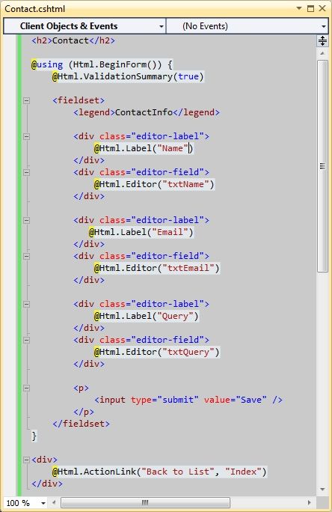
Built in HTML Helpers
Create a simple contact us form that will ask the user for his name, email id and his query. we can design this form in simple HTML easily, let us see how we can utilize HTML helper to achieve the same.
In this screenshot we can see that the HTML form is created using a HTML helper function, all the labels on the page are created using helper functions and all the textboxes are also created using helper functions. Now run the application and try to see the result.

Slide 9
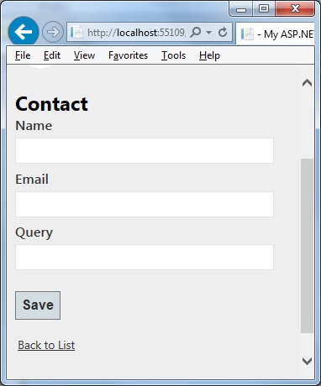
This is the page we see after we run the application.
Following HTML helpers are built into the ASP.NET MVC framework:
Html.BeginForm
Html.EndForm
Html.TextBox
Html.TextArea
Html.Password
Html.Hidden
Html.CheckBox
Html.RadioButton
Html.DropDownList
Html.ListBox

Slide 10
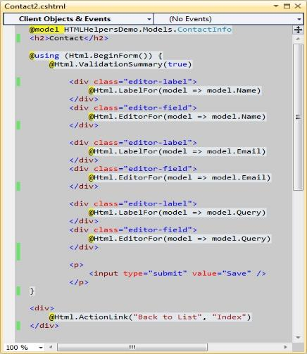
HTML Helpers for strongly typed views
If we are creating a strongly typed view then it is also possible to use the HTML helpers methods with the model class. Let us create a model “ContactInfo”for the contact us page:
public class ContactInfo
{
public string Name { get; set; }
public string Email { get; set; }
public string Query { get; set; }
}
Strongly typed view for contact us page using the Html helpers.

Slide 11
These helper methods create the output HTML elements based on model properties. The property to be used to create the HTML is passed to the method as a lambda expression. It could also be possible to specify id, name and various other HTML attributes using these helper methods. Following HTML helpers are available to be used with strongly typed views:
Html.TextBoxFor
Html.TextAreaFor
Html.PasswordFor
Html.HiddenFor
Html.CheckBoxFor
Html.RadioButtonFor
Html.DropDownListFor
Html.ListBoxFor

Slide 12
Books
Beginning ASP.NET 4: in C# and VB; Imar Spaanjaars,2010
Beginning ASP.NET 3.5 in C# 2008: From Novice to Professional; 2nd edition, Matthew MacDonald,2007
ASP.NET 3.5 Unleashed by Stephen Walther, 2008
Pro ASP.NET 3.5 in C# 2008: Includes Silverlight 2 by Matthew MacDonald,2008
ASP.NET 3.5 For Dummies by Ken Cox,2008

Slide 13
References
ASP.NET; URL: https://www.guru99.com/
URL: https://docs.microsoft.com/
Strongly typed views; URL: https://dotnettutorials.net/lesson
URL: https://www.tutlane.com/tutorial/aspnet-mv
URL: https://www.tutorialsteacher.com/mvc

Slide 14
Thank you!

